Slide 1
Improving Multimodal Fusion with Hierarchical Mutual Information Maximization for Multimodal Sentiment Analysis (MSA)
K M Ibrahim Khalilullah
Paper: Wei Han and Hui Chen and Soujanya Poria, “Improving Multimodal Fusion with Hierarchical Mutual Information Maximization for Multimodal Sentiment Analysis”, EMNLP, 2021.
Code: https://github.com/declare-lab/Multimodal-Infomax.

Slide 2
Introduction
Performance of a model highly depends on the quality of synthesized embeddings
These embeddings are generated from the upstream process called multimodal fusion
Aim to extract and combine the input unimodal raw data to produce a richer multimodal representation
Notes:
In multimodal sentiment analysis (MSA), the performance of a model highly depends on the quality of synthesized embeddings. These embeddings are generated from the upstream pro- cess called multimodal fusion, which aims to extract and combine the input unimodal raw data to produce a richer multimodal representtation. Previous work either back-propagates the task loss or manipulates the geometric property of feature spaces to produce favorable fusion results, which neglects the preservation of critical task-related information that flows from input to the fusion results. In this work, we propose a framework named MultiModal InfoMax (MMIM), which hierarchically maximizes the Mutual Information(MI) in unimodal input pairs (inter-modality) and between multimodal fusion result and unimodal input in order to maintain task-related information through multimodal fusion. The framework is jointly trained with the main task (MSA) to improve the performance of the downstream MSA task. To address the intractable issue of MI bounds, we further formulate a set of computationally simple parametric and non-parametric methods to approximate their truth value.

Slide 3
Introduction
Previous methods are limited to the lack of control in the information flow.
Proposed a hybrid approach called MultiModal InfoMax (MMIM)
To address the intractable issue of MI bounds, they formulate a set of computationally simple parametric and non-parametric methods to approximate their truth value.
Notes:
Previous methods are limited to the lack of control in the information flow that starts from raw inputs till the fusion embeddings, which may risk losing practical information and introducing unexpected noise carried by each modality.
In this work, we propose a framework named MultiModal InfoMax (MMIM), which hierarchically maximizes the Mutual Information(MI) in unimodal input pairs (inter-modality) and between multimodal fusion result and unimodal input in order to maintain task-related information through multimodal fusion. The framework is jointly trained with the main task (MSA) to improve the performance of the downstream MSA task. To address the intractable issue of MI bounds, we further formulate a set of computationally simple parametric and non-parametric methods to approximate their truth value.

Slide 4
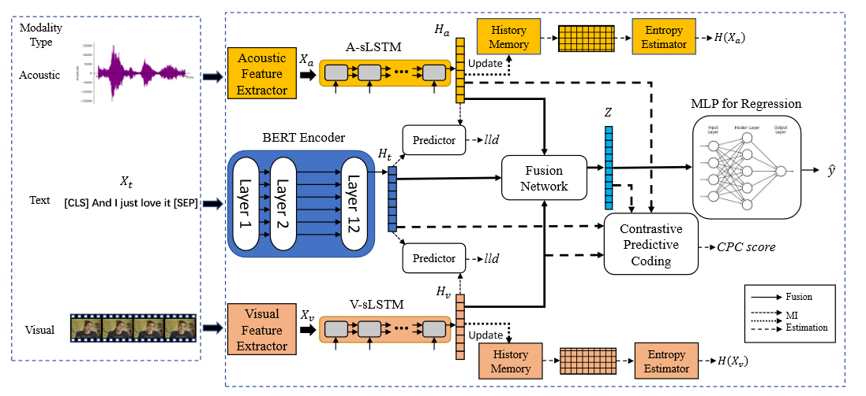
Overall Architecture
Tools: COVAREP and P2FA
Notes:
-> process raw input into numerical sequential vectors with feature extractor, firmware for visual and acoustic, tokenizer (BERT) for texts
-> we encode them into individual unit-length representations.
->The model then works in two collaborative parts—fusion and MI maximization, marked by solid and dash lines
->In the fusion part, a fusion network F of stacked linear-activation layers transforms the
unimodal representations into the fusion result Z, which is then passed through a regression multilayer perceptron (MLP) for final predictions.
->>> the MI lower bounds at two levels—input level and fusion level are estimated and boosted. The two parts work concurrently to produce task and MI-related losses for back-propagation, through which the model learns to infuse the task-related information into fusion results as well as improve the accuracy of predictions in the main task.

Slide 5

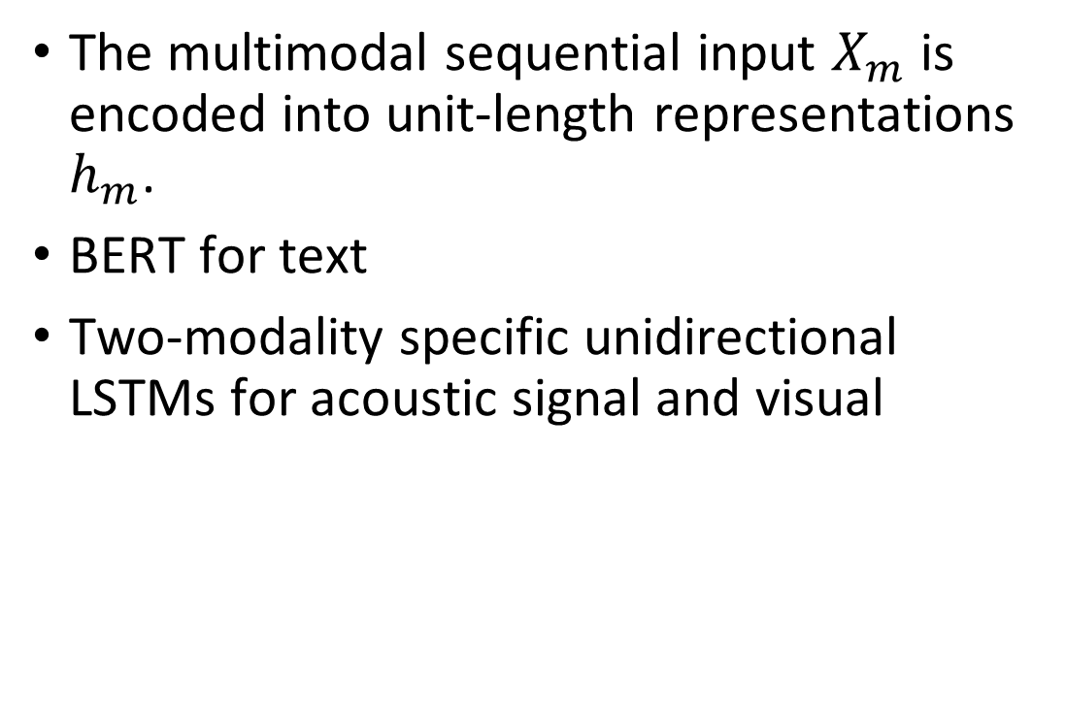
Modality Encoding
The multimodal sequential input $X_{m}$ is encoded into unit-length representations $h_{m}$.
BERT for text
Two-modality specific unidirectional LSTMs for acoustic signal and visual
Notes:
BERT (Devlin et al., 2019) to encode an input sentence and extract the head embedding from the last layer’s output as ht.
For visual and acoustic, we employ two modality-specific unidirectional to capture the temporal features of these modalities:

Slide 6
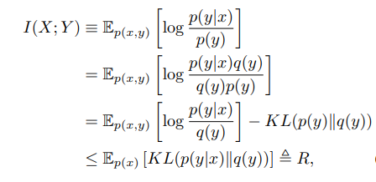
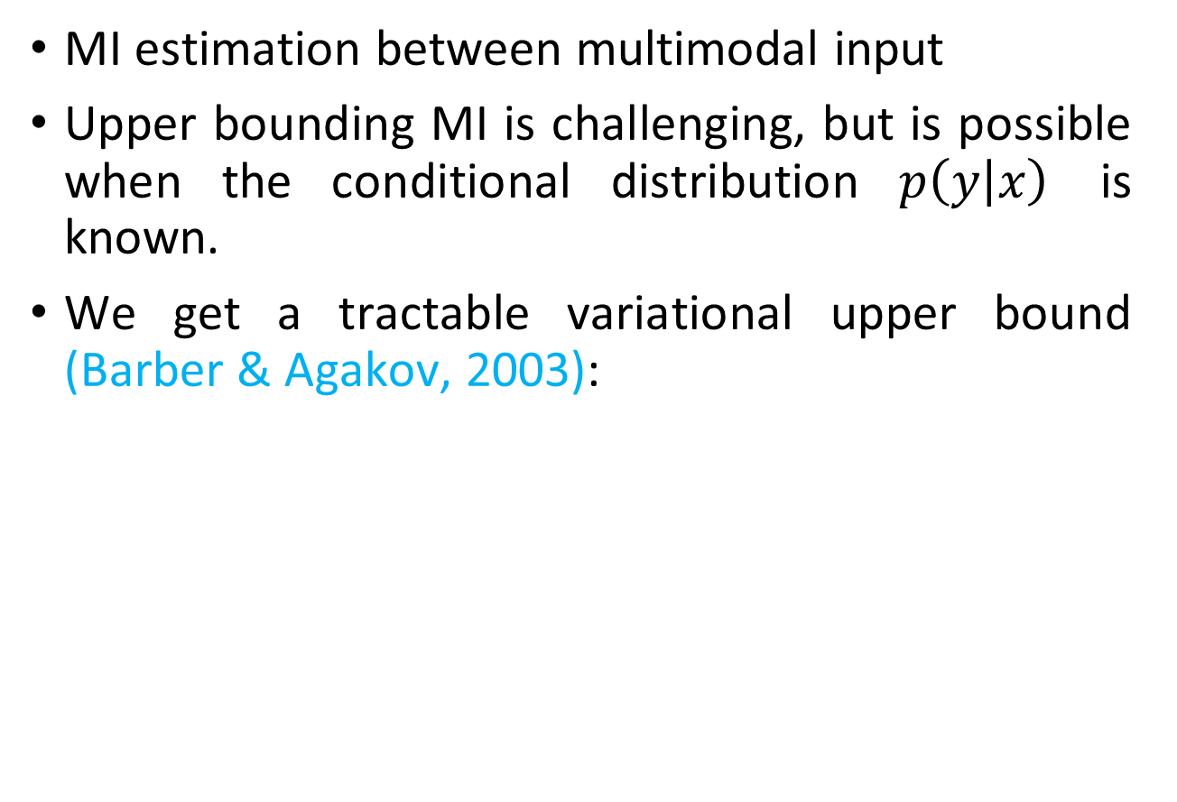
Inter-modality MI Maximization
MI estimation between multimodal input
Upper bounding MI is challenging, but is possible when the conditional distribution $p\left(y | x\right)$ is known.
We get a tractable variational upper bound (Barber & Agakov, 2003):
Barber, David and Felix V. Agakov. “The IM algorithm: a variational approach to Information Maximization.” NIPS 2003 (2003).
Notes:
Upper bounding MI is challenging, but is possible when the conditional distribution p(y|x) is known (e.g. in deep representation learning where y is the stochastic representation). We can build a tractable variational upper bound by introducing a variational approximation q(y) to the intractable marginal p(y) = R dx p(x)p(y|x). By multiplying and dividing the integrand in MI by a variational approximation q(y) and dropping a negative KL term, we get a tractable variational upper bound (Barber & Agakov, 2003):
which is often referred to as the rate in generative models (Alemi et al., 2017). This bound is tight when q(y) = p(y), and requires that computing log q(y) is tractable.

Slide 7
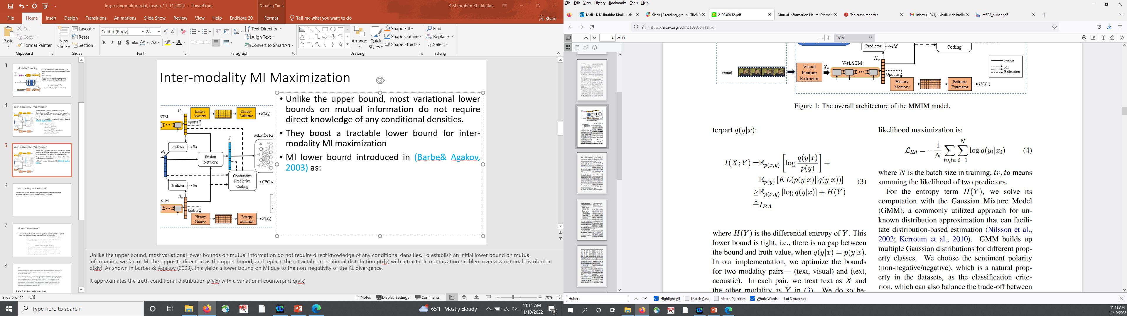
Inter-modality MI Maximization
Unlike the upper bound, most variational lower bounds on MI do not require direct knowledge of any conditional densities.
They boost a tractable lower bound for inter-modality MI maximization
MI lower bound introduced in (Barber & Agakov, 2003) as:
Barber, David and Felix V. Agakov. “The IM algorithm: a variational approach to Information Maximization.” NIPS 2003 (2003).
Notes:
Unlike the upper bound, most variational lower bounds on mutual information do not require direct knowledge of any conditional densities. To establish an initial lower bound on mutual information, we factor MI the opposite direction as the upper bound, and replace the intractable conditional distribution p(x|y) with a tractable optimization problem over a variational distribution q(x|y). As shown in Barber & Agakov (2003), this yields a lower bound on MI due to the non-negativity of the KL divergence.
It approximates the truth conditional distribution p(y|x) with a variational counterpart q(y|x)

Slide 8
Inter-modality MI Maximization
They optimize the bounds for two modality pairs— (text, visual) and (text, acoustic).
In each pair, they treat text as X and the other modality as Y.
Prediction from higher dimensional to lower ones converges faster with higher accuracy.
Text modality is predominate.
Notes:
where H(Y ) is the differential entropy of Y . This lower bound is tight, i.e., there is no gap between the bound and truth value, when q(y|x) = p(y|x). In our implementation, we optimize the bounds for two modality pairs— (text, visual) and (text, acoustic). In each pair, we treat text as X and the other modality as Y in (3). We do so because 1) Since we have to train a predictor q(y|x) to approximate p(y|x), prediction from higher- dimensional vectors ht ∈ Rdt (dt =768) to lower ones hv ∈ Rdv and ha ∈ Rda (dv, da ¡ 50) converges faster with higher accuracy; 2) many pre- vious works (Tsai et al., 2019a; Hazarika et al., 2020) pointed out that from empirical study the text modality is predominate, which can integrate more task-related features than other modalities in this step.

Slide 9
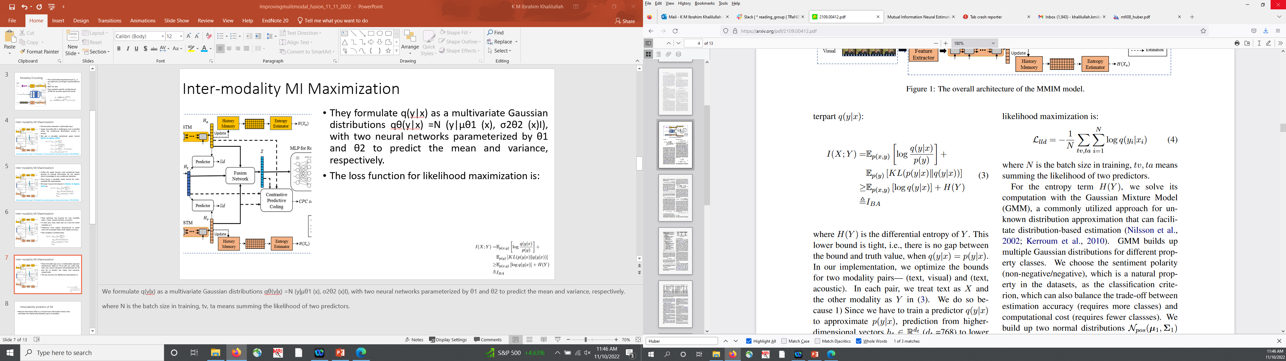
Inter-modality MI Maximization
They formulate q(y|x) as a multivariate Gaussian distributions q_{θ}(y|x) =N (y|μ_{θ1} (x), σ²_{θ2} (x)I), with two neural networks parameterized by θ1 and θ2 to predict the mean and variance, respectively.
The loss function for likelihood maximization is:
Notes:
We formulate q(y|x) as a multivariate Gaussian distributions qθ(y|x) =N (y|μθ1 (x), σ2θ2 (x)I), with two neural networks parameterized by θ1 and θ2 to predict the mean and variance, respectively.
where N is the batch size in training, tv, ta means summing the likelihood of two predictors.

Slide 10
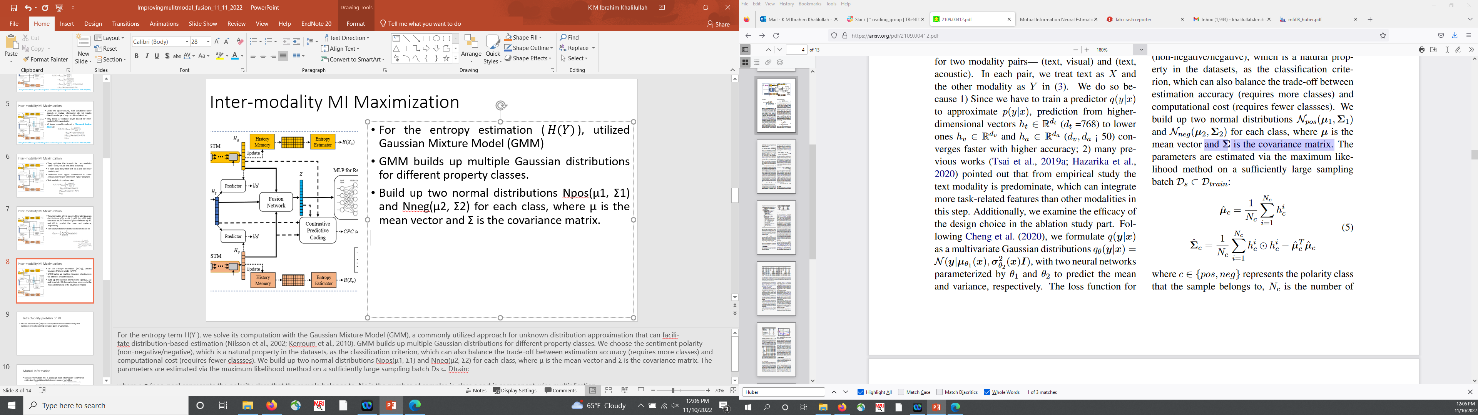
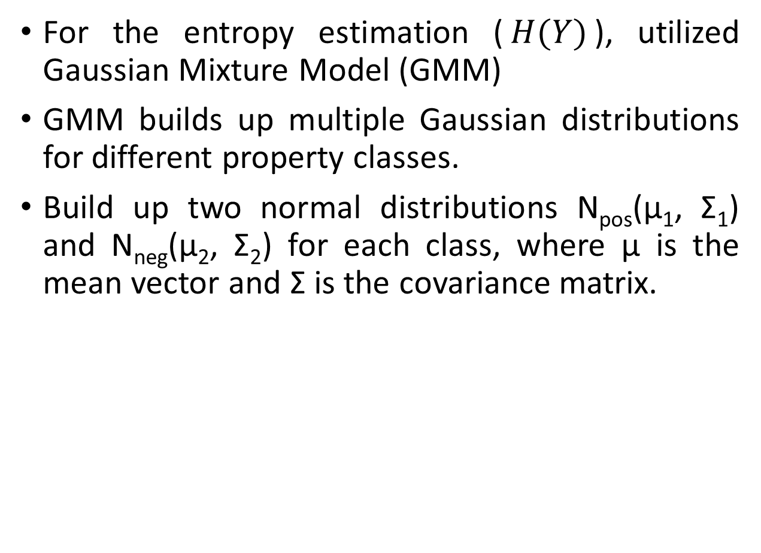
Inter-modality MI Maximization
For the entropy estimation ($H(Y)$), utilized Gaussian Mixture Model (GMM)
GMM builds up multiple Gaussian distributions for different property classes.
Build up two normal distributions N_{pos}(μ₁, Σ₁) and N_{neg}(μ₂, Σ₂) for each class, where μ is the mean vector and Σ is the covariance matrix.
Notes:
For the entropy term H(Y ), we solve its computation with the Gaussian Mixture Model (GMM), a commonly utilized approach for unknown distribution approximation that can facili- tate distribution-based estimation (Nilsson et al., 2002; Kerroum et al., 2010). GMM builds up multiple Gaussian distributions for different property classes. We choose the sentiment polarity (non-negative/negative), which is a natural property in the datasets, as the classification criterion, which can also balance the trade-off between estimation accuracy (requires more classes) and computational cost (requires fewer classses). We build up two normal distributions Npos(μ1, Σ1) and Nneg(μ2, Σ2) for each class, where μ is the mean vector and Σ is the covariance matrix. The parameters are estimated via the maximum likelihood method on a sufficiently large sampling batch Ds ⊂ Dtrain:
where c ∈ {pos, neg} represents the polarity class that the sample belongs to, Nc is the number of samples in class c and is component-wise multiplication.

Slide 11
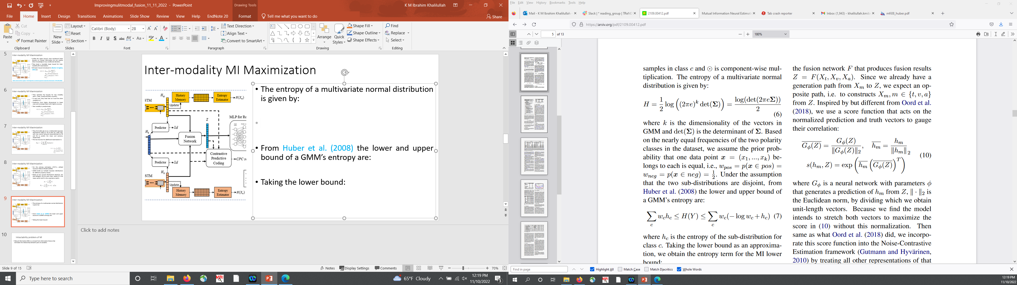
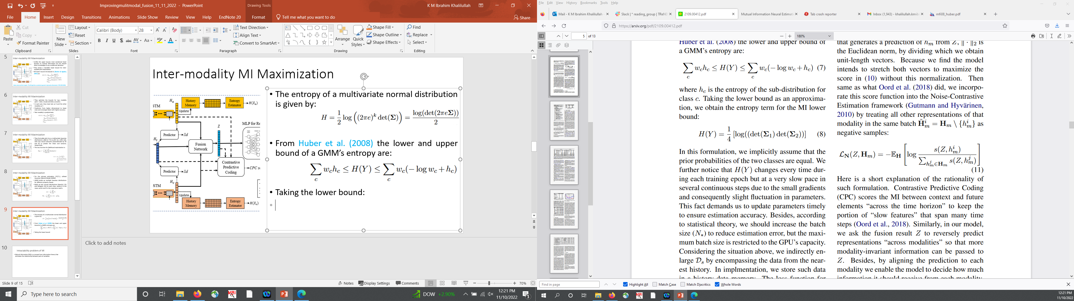
Inter-modality MI Maximization
The entropy of a multivariate normal distribution is given by:
From Huber et al. (2008) the lower and upper bound of a GMM’s entropy are:
Taking the lower bound:
M. F. Huber, T. Bailey, H. Durrant-Whyte and U. D. Hanebeck, "On entropy approximation for Gaussian mixture random vectors," 2008 IEEE International Conference on Multisensor Fusion and Integration for Intelligent Systems, 2008, pp. 181-188, doi: 10.1109/MFI.2008.4648062.
Notes:
where k is the dimensionality of the vectors in GMM and det(Σ) is the determinant of Σ. Based on the nearly equal frequencies of the two polarity classes in the dataset, we assume the prior prob- ability that one data point x = (x1, ..., xk) belongs to each is equal, i.e., wpos = p(x ∈ pos) =wneg = p(x ∈ neg) = 12 . Under the assumption that the two sub-distributions are disjoint, from Huber et al. (2008) the lower and upper bound of a GMM’s entropy are:
where hc is the entropy of the sub-distribution for class c. Taking the lower bound as an approximation, we obtain the entropy term for the MI lower bound:
In this formulation, we implicitly assume that the prior probabilities of the two classes are equal.

Slide 12
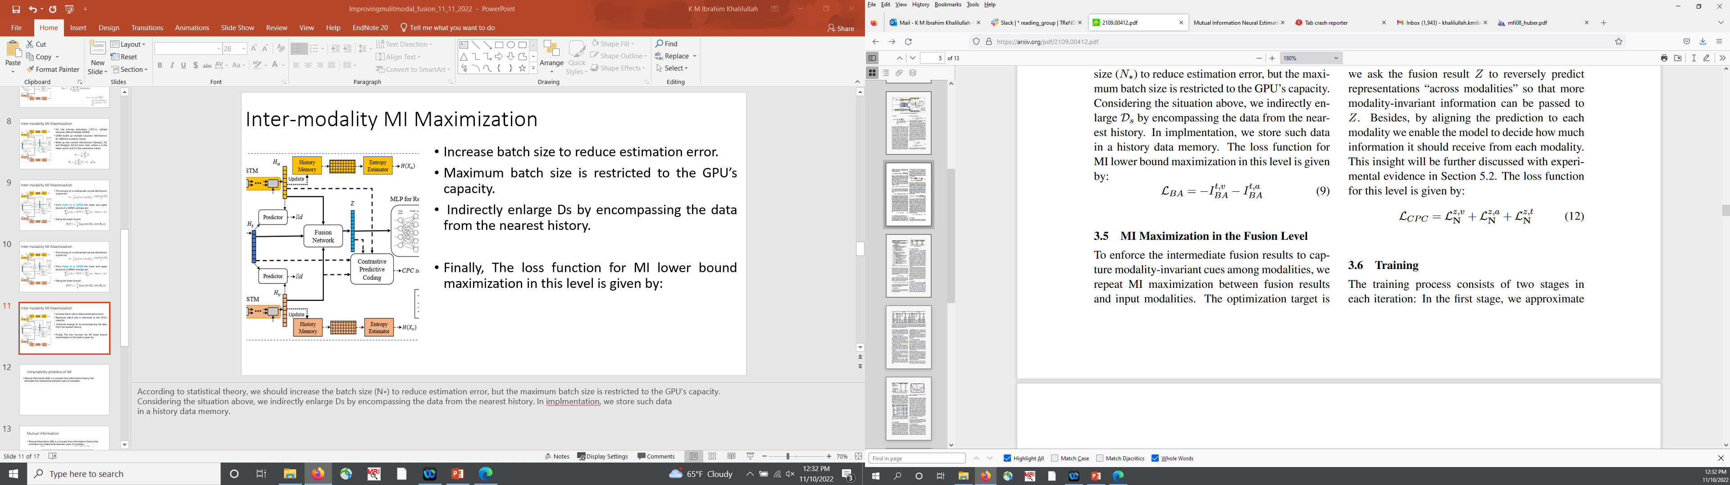
Inter-modality MI Maximization
Increase batch size to reduce estimation error.
Maximum batch size is restricted to the GPU’s capacity.
Indirectly enlarge Ds by encompassing the data from the nearest history.
Finally, The loss function for MI lower bound maximization in this level is given by:
Notes:
According to statistical theory, we should increase the batch size (N∗) to reduce estimation error, but the maximum batch size is restricted to the GPU’s capacity. Considering the situation above, we indirectly enlarge Ds by encompassing the data from the nearest history. In implementation, we store such data in a history data memory.

Slide 13
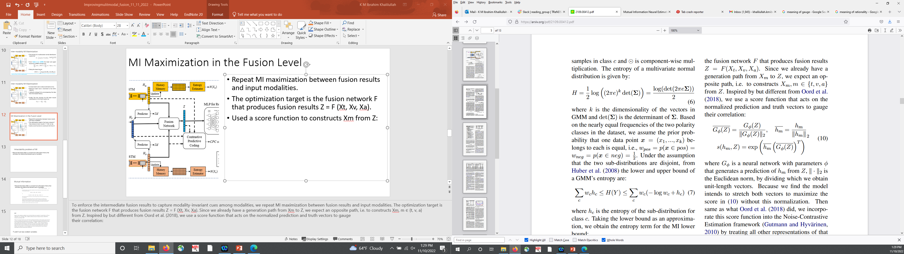
MI Maximization in the Fusion Level
Repeat MI maximization between fusion results and input modalities.
The optimization target is the fusion network F that produces fusion results
Used a score function to constructs Xm from Z:
Notes:
To enforce the intermediate fusion results to capture modality-invariant cues among modalities, we repeat MI maximization between fusion results and input modalities. The optimization target is
the fusion network F that produces fusion results Z = F (Xt, Xv, Xa). Since we already have a generation path from Xm to Z, we expect an opposite path, i.e. to constructs Xm, m ∈ {t, v, a} from Z. Inspired by but different from Oord et al. (2018), we use a score function that acts on the normalized prediction and truth vectors to gauge their correlation:
where Gφ is a neural network with parameters φ that generates a prediction of hm from Z, ‖ · ‖2 is the Euclidean norm, by dividing which we obtain unit-length vectors.

Slide 14
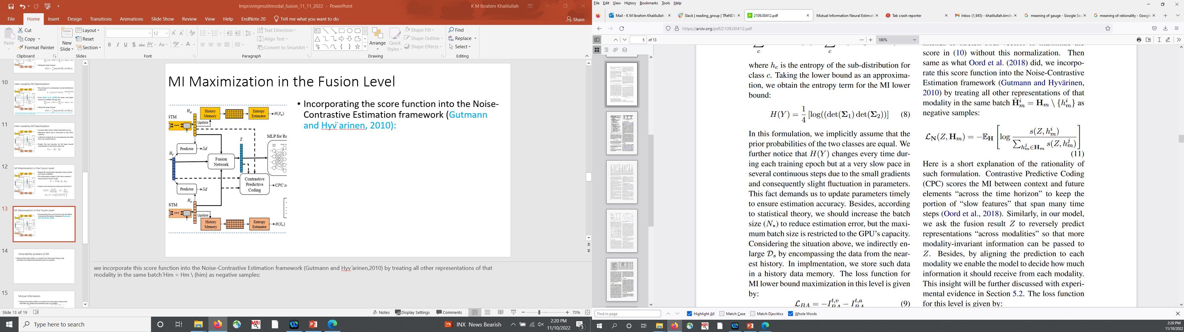
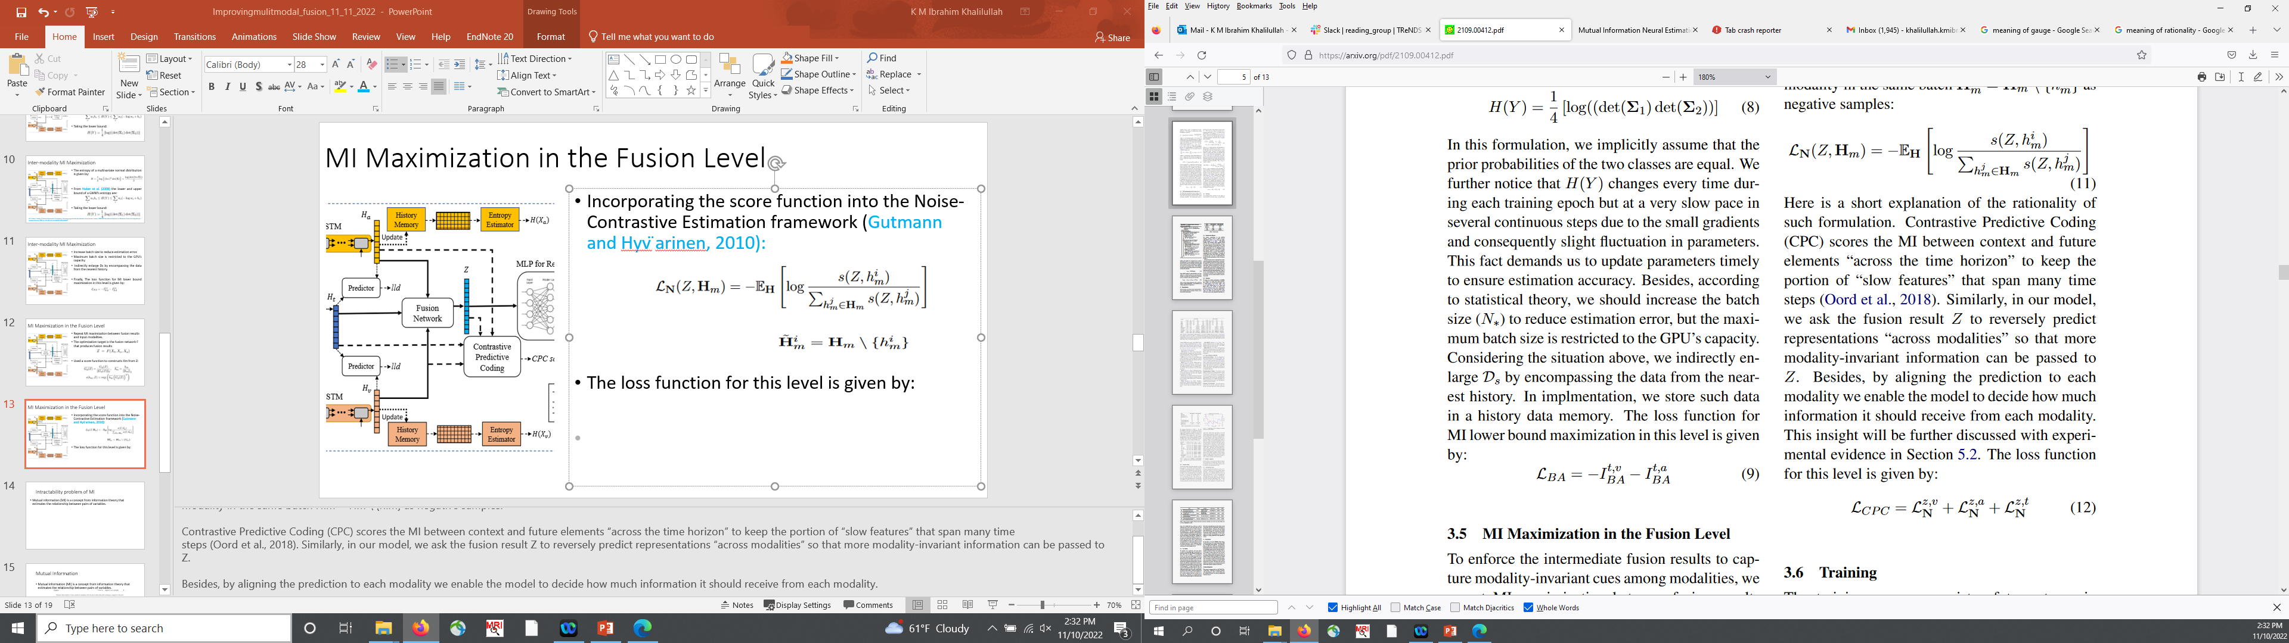
MI Maximization in the Fusion Level
Incorporating the score function into the Noise-Contrastive Estimation framework (Gutmann and Hyv ̈arinen, 2010):
The loss function for this level is given by:
Notes:
we incorporate this score function into the Noise-Contrastive Estimation framework (Gutmann and Hyv ̈arinen,2010) by treating all other representations of that modality in the same batch ̃Him = Hm \ {him} as negative samples:
Contrastive Predictive Coding (CPC) scores the MI between context and future elements “across the time horizon” to keep the portion of “slow features” that span many time steps (Oord et al., 2018). Similarly, in our model, we ask the fusion result Z to reversely predict representations “across modalities” so that more modality-invariant information can be passed to Z.
Besides, by aligning the prediction to each modality we enable the model to decide how much information it should receive from each modality.

Slide 15
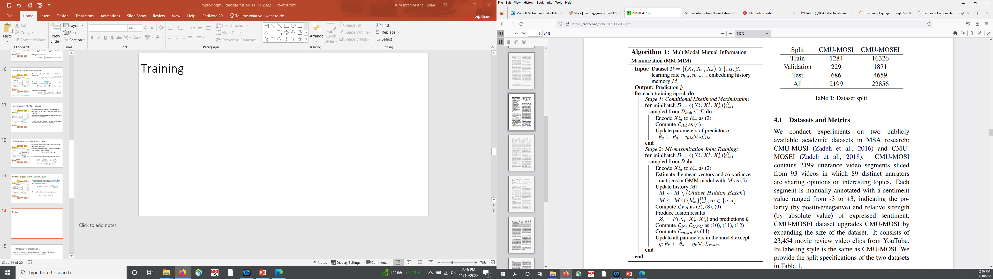
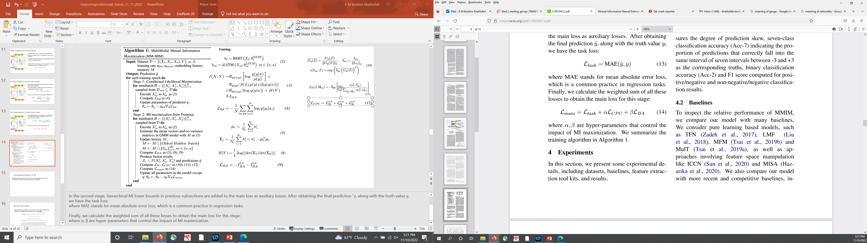
Training
Notes:
The training process consists of two stages in each iteration: In the first stage, we approximate p(y|x) with q(y|x) by minimizing the negative log-likelihood for inter-modality predictors with the loss in (4).
In the second stage, hierarchical MI lower bounds in previous subsections are added to the main loss as auxiliary losses. After obtaining the final prediction ˆy, along with the truth value y, we have the task loss:
where MAE stands for mean absolute error loss, which is a common practice in regression tasks.
Finally, we calculate the weighted sum of all these losses to obtain the main loss for this stage:
where α, β are hyper-parameters that control the impact of MI maximization.

Slide 16
Conclusion
Applied MI lower bound at both the input label and fusion label
To maximize MI hierarchically
Performed ablation study
Code: https://github.com/declare-lab/Multimodal-Infomax.

